Slide 1
Intro to RNA-Seq
Week 1 Day 2 BIOM262
Emily Wheeler

Slide 2
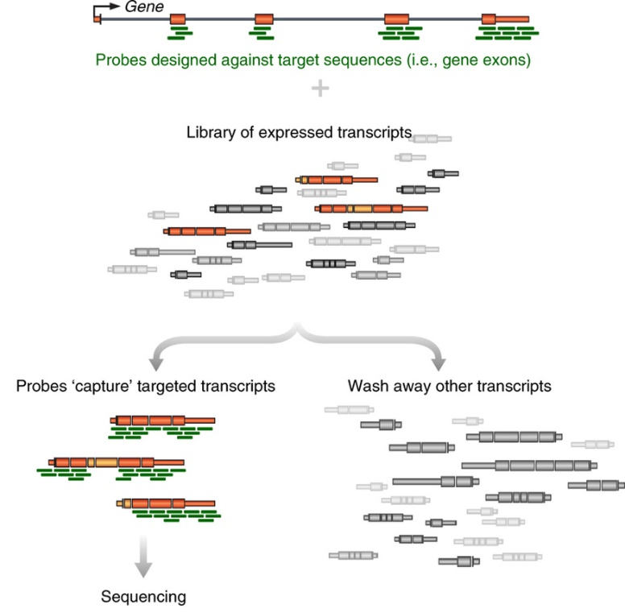
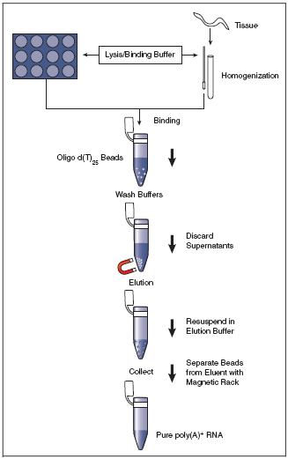
Generating RNA-seq libraries
Step 1: What RNA do you want to profile?
mRNA only -> PolyA selection
Specific RNAs -> targeted enrichment
(All mRNAs are polyadenylated at the 3’ end – can use d(T)₂₅ beads to select)

Slide 3
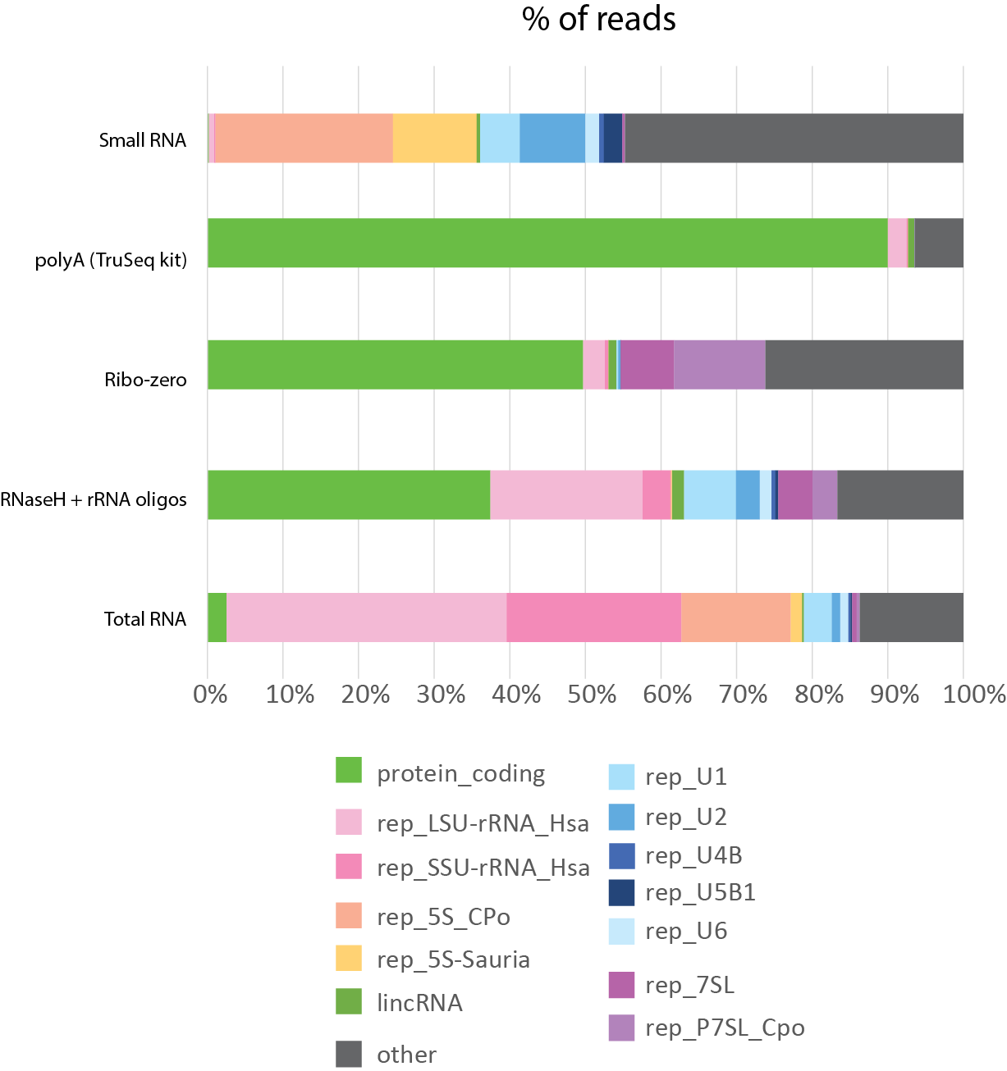
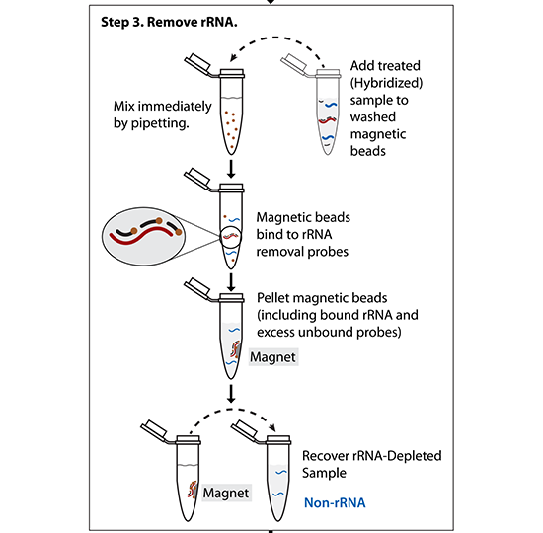
Step 1: What RNA do you want to profile?
Total RNA -> ribosomal RNA depletion
(Ribo-zero)
(Other methods – hybridize targeted DNA oligos + RNAseH treat)

Slide 4
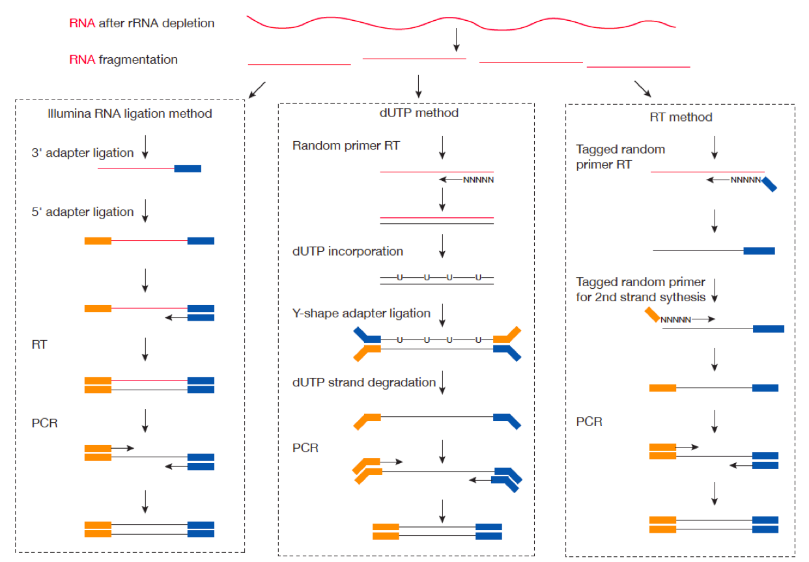

Slide 5
Illumina sequencing – fragment strategy
I5 adapter
Read1 primer
DNA insert (your library)
Read2* primer
I7 adapter
Flow Cell Surface
I5 index*
I7 index*
* optional
Reaction #
Flow Cell Surface
1
Read1 primer
Read1 sequence
Flow Cell Surface
2*
Index1 primer
Index1 sequence

Slide 6
Illumina sequencing – Paired End & Dual Indexing
Reaction #
Flow Cell Surface
1
Read1 primer
Read1 sequence
Flow Cell Surface
2*
Index1 primer
Index1
(I7) sequence
Flow Cell Surface
3*
Index2 primer
Index2
(I5) sequence
Flow Cell Surface
4*
Read2 primer
Read2
sequence
* optional

Slide 7
Illumina sequencing – great for read #, not great for read length
Quality score
0
100
200
300
400
Cycle #

Slide 8
Fastq File
First line is the information about the location of the read and specific sequencing machine used:
Second line is the nucleotide sequence called
Third line is “+” and can optionally be followed by a repeat of the filename in line 1
Fourth line contains the quality score as determined by the sequencer
@NS500672:54:HL775BGXX:1:11101:22716:1042 1:N:0:CCCCGG
CCGCCNATGCCCATGCCACAGTTGTTGAGCTTGAGTTCCTGCAGGGTGAAGCAGGCTGAGCTCTTGAGCAGGGCCTCGAA
+
AAAAA#EEEEEEEEEEEEEEEEEEEEEEEEEEEEEEEEEEEEEEEEEEEEEEEEEAEEEEEEEEEEEEEEEEEEEEEEEE
Notes:
Four lines represent 1 read off the machine

Slide 9
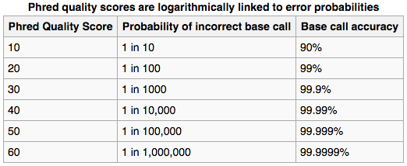
Fastq File – Phred Quality Score
Quality scores report the probability that the base call is incorrect
Field standard is to accept bases with quality >20
Notes:
Four lines represent 1 read off the machine
Quality scores have been converted into the ascii code for reporting… not important here

Slide 10
How do you align reads to a genome?
What is the sequence of our chromosomes – Reference Genome – Fasta file
What do we know about where genes are located on those chromosomes – Genome Annotation – GTF file

Slide 11
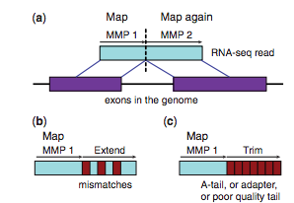
Things to Consider when aligning RNA

Slide 12
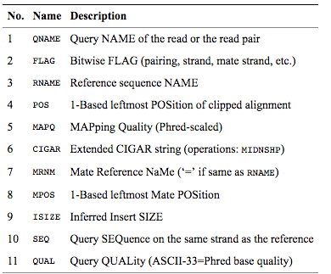
BAM File
BAM files are binary, you must use samtools to view them
Bioinformatics. 2009 Aug 15;25(16):2078-9. Epub 2009 Jun 8. The Sequence Alignment/Map format and SAMtools.
Notes:
Four lines represent 1 read off the machine

Slide 13
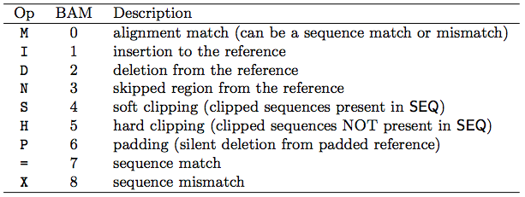
CIGAR String
Contains specific information about the mapping information at specific positions across the read
Bioinformatics. 2009 Aug 15;25(16):2078-9. Epub 2009 Jun 8. The Sequence Alignment/Map format and SAMtools.

Slide 14
RNA-Seq Analysis Overview:
Download Data
(fastq)
Check Quality (fastqc)
Align to Genome (STAR)
Sort and Index BAM (samtools)
Count Reads Mapped to Genes (featureCounts)
Differential Expression (DESeq2)
Interesting Biology!

